Slide 1
PROJECT REPORT
METHODOLOGY TO SOLVE THE EMPLOYEE ATTRITION PROBLEM
BY
OSAZEMEN ORIAKHI

Slide 2
The Data
The data is for company X which is trying to control employee attrition. There are two sets of data: “Existing employees” and “Employees who have left”. Each employee having the following attributes; Satisfaction level, Last evaluation, Number of projects, Average monthly hour, Time spent at the company, Whether they have had a work accident, Whether they have had a promotion in the last 5 years, Departments (column sales), Salary, Whether the employee has left.

Slide 3
Methodology
Using the Jupiter notebook, I carried out my methodological steps in Python programing language through the following steps:
I imported the necessary libraries needed for the analysis. They include;
pandas, numpy, matplotlib, seaborn, math, sklearn.linear _model, sklearn.model_selection, sklearn.
I loaded the dataset (excel sheet) from my computer storage into the worksheet.
using the pandas.read_excel() function and verified whether it was successfully loaded. I then converted it to data frame named Attrition.
Some of the data were categorical and needed to be encoded.

Slide 4
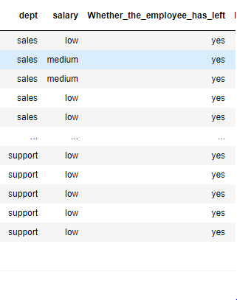
Methodology
Fig. 1: Categorical Variables in the Data set

Slide 5
Methodology (Encoding)
The target variable, ‘whether the employee has left’, is categorical and machine learning algorithm doesn’t work with non-numerical values. Hence, it should be encoded.
from sklearn.preprocessing module, I imported the LabelEncoder library and used it to encode the target variable into binary form:
1 – yes
0 – No
Then I saved it under a new column ‘Left’

Slide 6
Methodology (Encoding)
For the independent variables, we had two features that were categorical; Dept and Salary.
Dept had 10 categories, while salaries had three categories as shown in fig 1.
Using the get_dummies function in pandas, I encoded the data, also shown in fig 1.

Slide 7
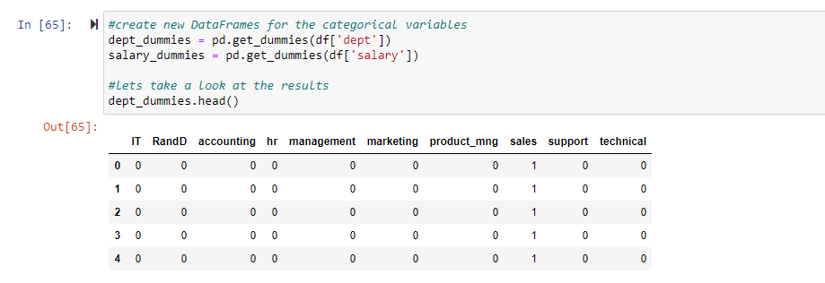
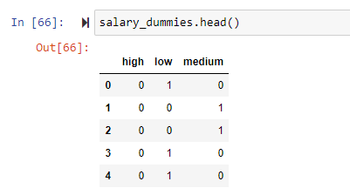
Methodology (encoding)
Fig. 2: Encoding the ‘Dept’ and ‘Salary’ categorical data using get_dummies function.

Slide 8
Methodology (encoding)
I did a little visualization on the data. I used feature plot in seaborn module to plot ‘Left’ target values against ‘Number of projects’ values.
From the plot shown in fig 2, it was seen that employees with higher number of projects left the company aside from those who had 3 projects, because they have gained more valuable experience for better offers.
I also plotted ‘Left’ target values against ‘time spent in the company’ and I saw that the employees that left, increased from 1 to 5 but decreased afterwards from 6 to 10. that means, early comers are more prone to leave if they aren’t satisfied with the offer compared to older employees.

Slide 9
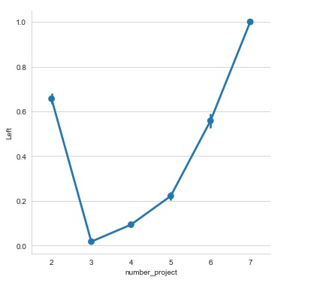
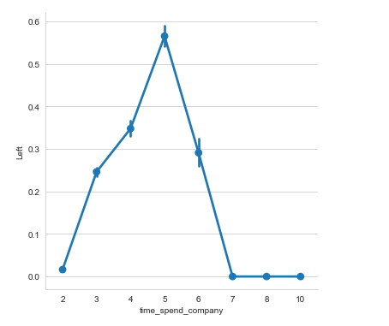
Methodology (Data Visualization)
Fig. 3: Data visualization on the data

Slide 10
Methodology (Analysis)
To prepare the data for processing, I dropped all the columns having categorical non numerical values to form the independent variables (A). And then using the pandas concat function, I added the encoded columns to the independent variable dataset (A).
I also set up the dependent (target variable) as ‘B’, consisting of the encoded ‘Left’ data.
To avoid multicollinearity of the dummy variables, I dropped one column from the ‘dept.’ dummy and the ‘salary’ dummy.
I dropped the ‘Hr’ dept. column and the ‘High’ salary column.
I flattened the ‘B’ array to fit into the machine learning algorithm.

Slide 11
Methodology (Logistic Regression)
Using the LogisticRegression() function, I fitted my data to the model and evaluated the accuracy. It gave 80% accuracy.
The mean value of the target variable ‘B’ is 0.24 = 24%. Which represents the fraction of employees who left. It therefore means that the percentage of employees who stayed is 76% which is far from 80%.
To know the stronger predictors, I checked the coefficients of each features gotten by the model. Shown in fig. 3. the features with positive coefficients are strong predictors and vice versa.

Slide 12
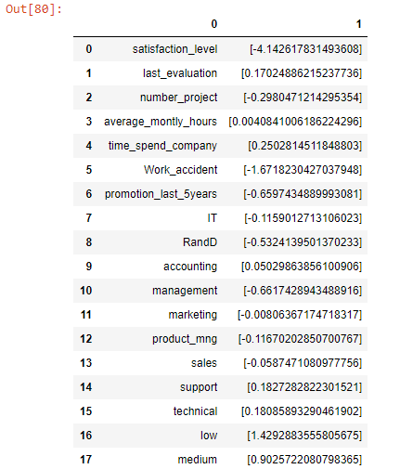
Methodology
Fig. 4: Coefficients of each features, gotten from the model

Slide 13
Methodology (RESULTS)
I split the data into train and test sets using the train_test_split finction.
25% of total data were picked at random to be the test set, while the remaining 75% were used to train the model.
Running the code, I got an accuracy of 79.4%. This isn’t far from the initial result.
I then did a prediction analysis using the predict function on the model to get the list of future employees who are likely to leave. I converted the results to an excel file, attached to this presentation.

Slide 14
Methodology
I then found the individual probabilities that resulted in my prediction results.
And voila! Problem solved!

Slide 15
THANK YOU!

